Slide 1
Chapter 1 Introducing C

Slide 2
Origins of C
C is a by-product of UNIX, developed at Bell Laboratories by Ken Thompson, Dennis Ritchie, and others.
Thompson designed a small language named B.
B was based on BCPL, a systems programming language developed in the mid-1960s.

Slide 3
Origins of C
By 1971, Ritchie began to develop an extended version of B.
He called his language NB (“New B”) at first.
As the language began to diverge more from B, he changed its name to C.
The language was stable enough by 1973 that UNIX could be rewritten in C.

Slide 4
Standardization of C
K&R C
Described in Kernighan and Ritchie, The C Programming Language (1978)
De facto standard
C89/C90
ANSI standard X3.159-1989 (completed in 1988; formally approved in December 1989)
International standard ISO/IEC 9899:1990
C99
International standard ISO/IEC 9899:1999
Incorporates changes from Amendment 1 (1995)

Slide 5
C-Based Languages
C++ includes all the features of C, but adds classes and other features to support object-oriented programming.
Java is based on C++ and therefore inherits many C features.
C# is a more recent language derived from C++ and Java.
Perl has adopted many of the features of C.

Slide 6
Properties of C
Low-level
Small
Permissive

Slide 7
Strengths of C
Efficiency
Portability
Power
Flexibility
Standard library
Integration with UNIX

Slide 8
Weaknesses of C
Programs can be error-prone.
Programs can be difficult to understand.
Programs can be difficult to modify.

Slide 9
Effective Use of C
Learn how to avoid pitfalls.
Use software tools (lint, debuggers) to make programs more reliable.
Take advantage of existing code libraries.
Adopt a sensible set of coding conventions.
Avoid “tricks” and overly complex code.
Stick to the standard.

Slide 10
週次 | 日期 | 課程計畫
1 | 09/27 ~ 10/01 | 第一、二章 (Introducing C, C Fundamentals)
2 | 10/04~ 10/08 | 第三、四章 (Formatted IO, Expressions)
3 | 10/11 ~ 10/15 | 第五、六章 (Selection Statement, Loops)
4 | 10/18 ~ 10/22 | 第七章 (Basic Types)
5 | 11/01 ~ 11/05 | 第二十、二十四章 (Input, Output, Error Handling)
6 | 11/08 ~ 11/12 | 第八章 (Arrays)
7 | 11/15 ~ 11/19 | 期中考
8 | 11/15 ~ 11/19 | 第九、十章 (Functions, Program Organization)
9 | 11/22 ~ 11/26 | 第十一章 (Pointers)
10 | 11/29 ~ 12/03 | 第十二章 (Pointers and Arrays)
11 | 12/13 ~ 12/17 | 第十三章 (Strings)
12 | 12/20 ~ 12/24 | 期中
13 | 12/20~ 12/24 | 第十四、十五章 (The Preprocessor, Writing Large Programs)
14 | 12/27 ~ 12/31 | 第十六章 (Structure Union)
15 | 01/03 ~ 01/07 | 第十七章 (Advanced uses of Pointer)
16 | 01/10 ~ 01/14 | 期末
17 | 01/17 ~ 01/21 | 分數訂正

Slide 11
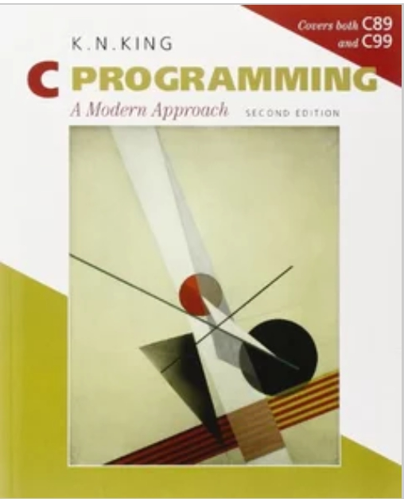
Text Book
C Programming: A Modern Approach, 2/e (Paperback)

